Slide 1


What is the relationship between atypical features of facial emotion recognition function and white matter microstructure alterations in autism?
Peking University
Xing Su†, Siuching Kat†, Hui Wang, Zenghui Ma, Tingni Yin, Liyang Zhao, Shuchen Peng, Xiaoyun Gong, Qinyi Liu, Gangqiang Han, Xue Li*, Yanqing Guo*, and Jing Liu*
Date：2022.11.13

Slide 2
Contents
1
Background
2
Aim and hypothesis
3
Methods
4
Results
5
Discussion
Peking University
6
Limitation and Conclusion

Slide 3

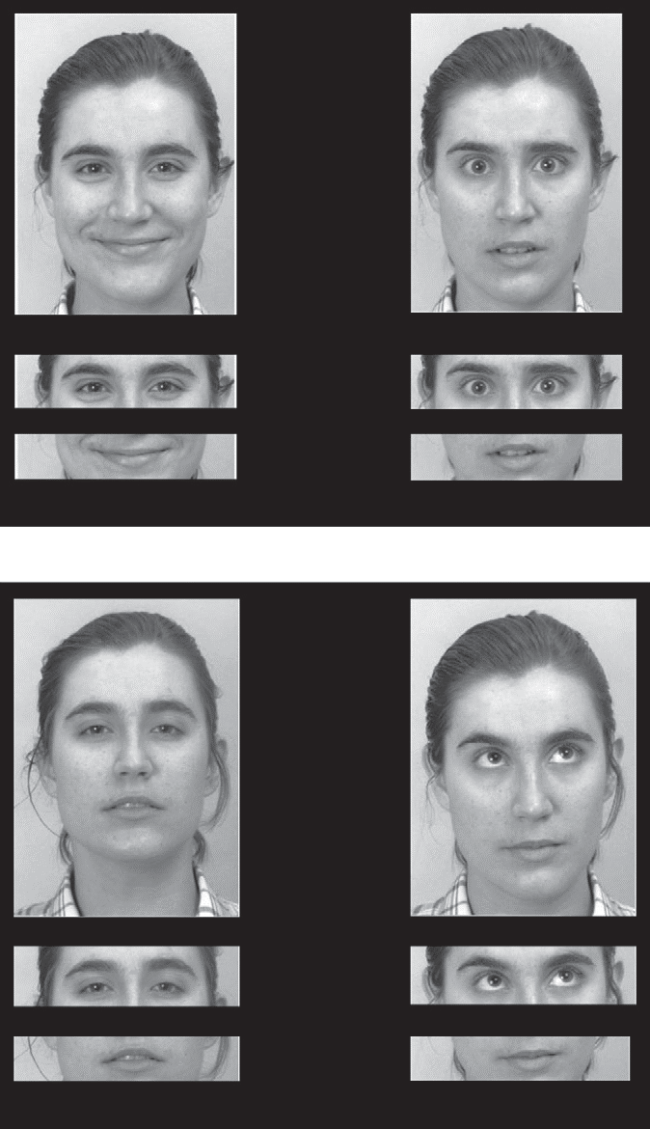
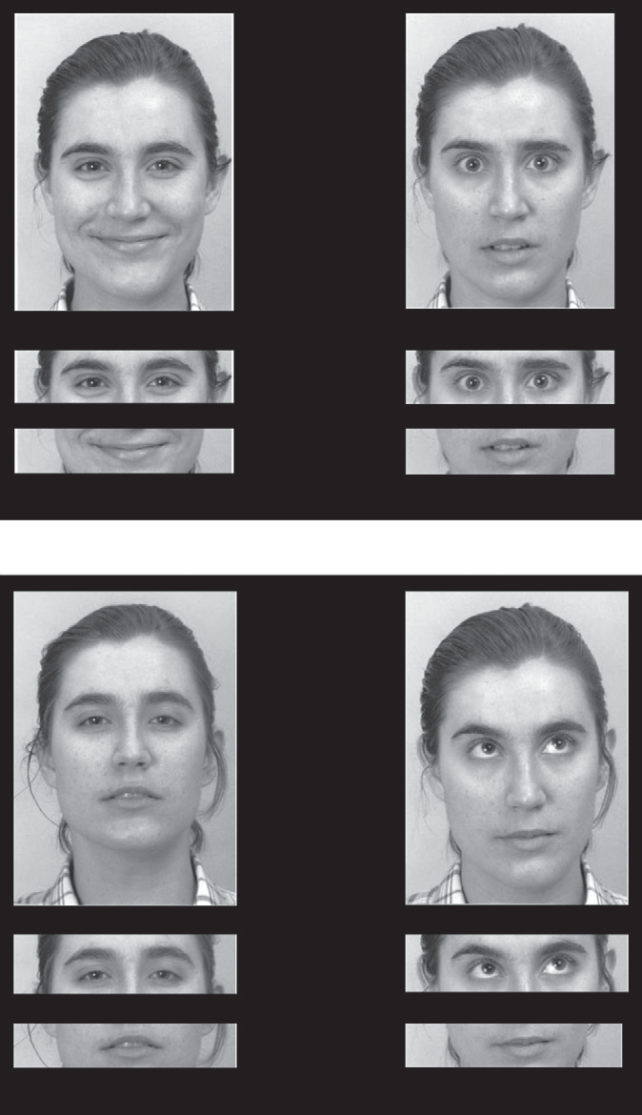
Facial emotion recognition (FER) refers to a person‘s perception of a particular emotional state through the interpretation of facial features (Marco-Garcia et al., 2019), and it includes basic FER and complex FER.

Slide 4
Autism Spectrum Disorder (ASD) is a neurodevelopmental disorder that occurs in the early developmental period (US, 2013).
category | Number of studies | FER deficits（YES /ALL）
Basic FER | 76 | neural（5/20）；fear (13/61)；disgusting(8/41); sad(10/58)；anger(10/67)；happy(5/ 64)；surprising (1/42)
Complex FER | 12 | 10/12
Basic VS Complex | 2
Notes:
It is characterized by impairments in social communication and interaction, limited interests, and repetitive behaviors

Slide 5
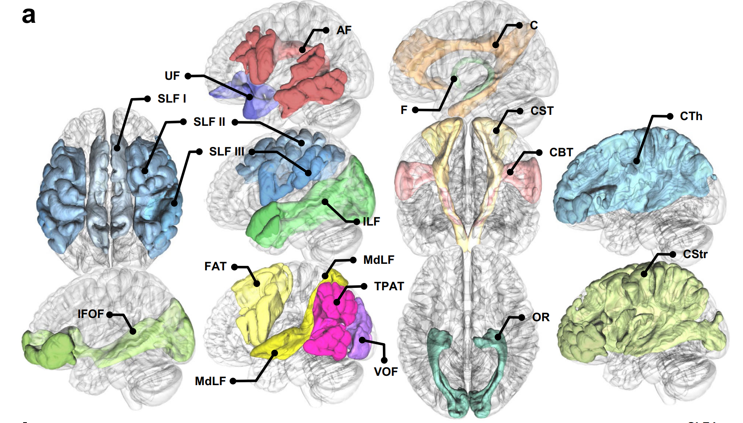
White matter alterations in the ASD group were not correlated with FER function (Li et al. )
FER was associated with the white matter structure of the ventral occipital complex, superior temporal/parietal association areas, and forceps major of the corpus callosum in the ASD group (Yasuno et al).
Yeh, F. C. (2022). Nat Commun, 13(1), 4933. doi:10.1038/s41467-022-32595-4
Notes:
corpus callosum (CC), corona radiata (CR), superior longitudinal fasciculus (SLF), inferior longitudinal fasciculus (ILF), and uncinate fasciculus(Aoki et al., 2017; Fitzgerald, Gallagher, & McGrath, 2019; Zhao, Yang, Gong, Cao, & Liu, 2022)).

Slide 6

Hypothesis
What are the basic and complex FER features of medication-naïve and comorbidity-free ASD individuals?
What is the relationship between white matter microstructure and FER features in these individuals?
ASD: poorer performance on the different FER measures
ASD: white matter microstructure alterations
ASD: atypical correlation between FER and white matter measures
basic facial emotions would be recognized more easily than complex facial emotions
the correlations between two kinds of FER and white matter measures would be different.

Slide 7
Methods
Participants
IQ＞70; right-handed; 6 - 18 years; Han ethnicity
59 medication-naïve and comorbidity-free ASD participants
59 age- and IQ-matched typically developed (TD) individuals
FER tasks: RME (basic emotions and complex emotions)
MRI: GE Discovery750 3.0T
Statistical analysis
Tract-Based Spatial Statistics
covariance analysis
2(group)×2(emotion category) repeated-measures Analysis of Variance

Slide 8

ANOVA and 2×2 repeated-measures ANOVA results of basic and complex FER tasks between ASD and TD
 | F | p | η2/partialη2
Basic FER
Group | 6.473（1，91） | 0.013 | 0.066
group*age | 1.015（1，88） | 0.317 | 0.011
group*gender | 1.163（1，88） | 0.284 | 0.013
group*IQ | 3.493（1，88） | 0.065 | 0.038
Complex FER
Group | 8.503（1，91） | 0.004 | 0.085
group*age | 0.211 （1，88） | 0.647 | 0.002
group*gender | 0.385（1，88） | 0.537 | 0.004
group*IQ | 2.170（1，88） | 0.144 | 0.024
2×2 repeated-measures ANOVA
Group | 5528.873（1，94） | 0.000 | 0.983
Emotion category | 73.260（1，94） | 0.000 | 0.438
group*emotion category | 0.013 （1，94） | 0.908 | 0.000

Slide 9
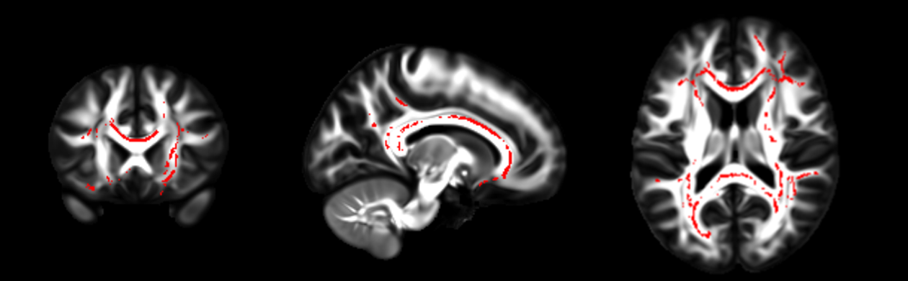
Fig.1 Adjusted for sex, age, IQ, and head motion, the map of clusters showed weaker FA in the ASD group compared to the TD group. The red color shows corpus callosum, corona radiata, internal capsule, posterior thalamic radiation, superior longitudinal fasciculus, and tapetum.

Slide 10
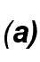
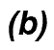
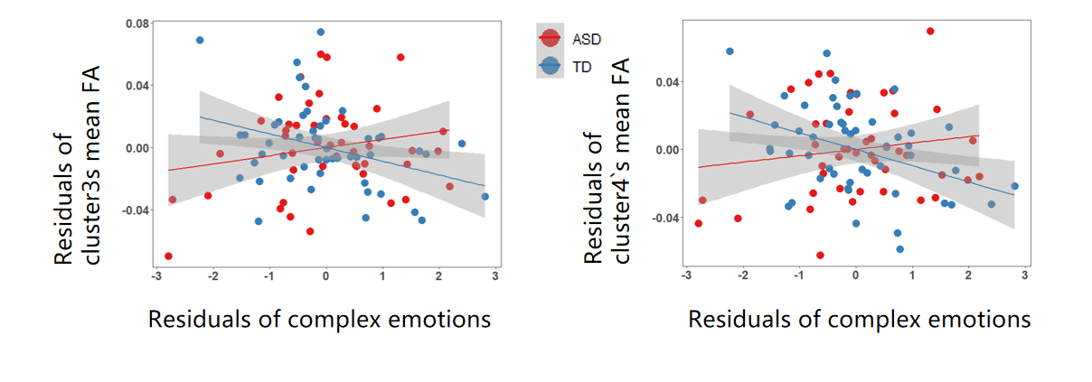
Fig.2 Partial correlation of FA and complex FER. (a) The scatter plot shows the residuals of the mean FA of cluster 3 on the vertical axis and the residuals of the FER score on the horizontal axis. (b) The scatter plot shows the residuals of the mean FA of cluster 4 on the vertical axis and the residuals of the FER score on the horizontal axis.
cluster3 r=0.347， cluster4 r=0.382

Slide 11
Discussion
ASD vs TD
ASD individuals showed deficits in basic and complex FER
ASD individuals show alterations of white matter microstructure
ASD individuals show atypical relationship between FER and white matter microstructure
Basic FER vs Complex FER
Basic facial emotions were easier to recognize than complex facial emotions
They show different relationships with white matter microstructure

Slide 12
Conclusion
sex ratio was different between the ASD group and the TD group
this study did not include subjects with intellectual impairment
FER tasks in this study used non-ethnic pictures
TBSS analysis cannot delineate the specific segments
Specific mechanism whiter matter has in FER deficit remains unclear.
ASD individuals have basic and complex FER deficits and WMS alterations, where the latter is potentially among the neural mechanisms underlying the complex FER deficits in ASD.

Slide 13
Thanks for your listening
Notes:
脑白质和社会认知障碍的关系

